Slide 1
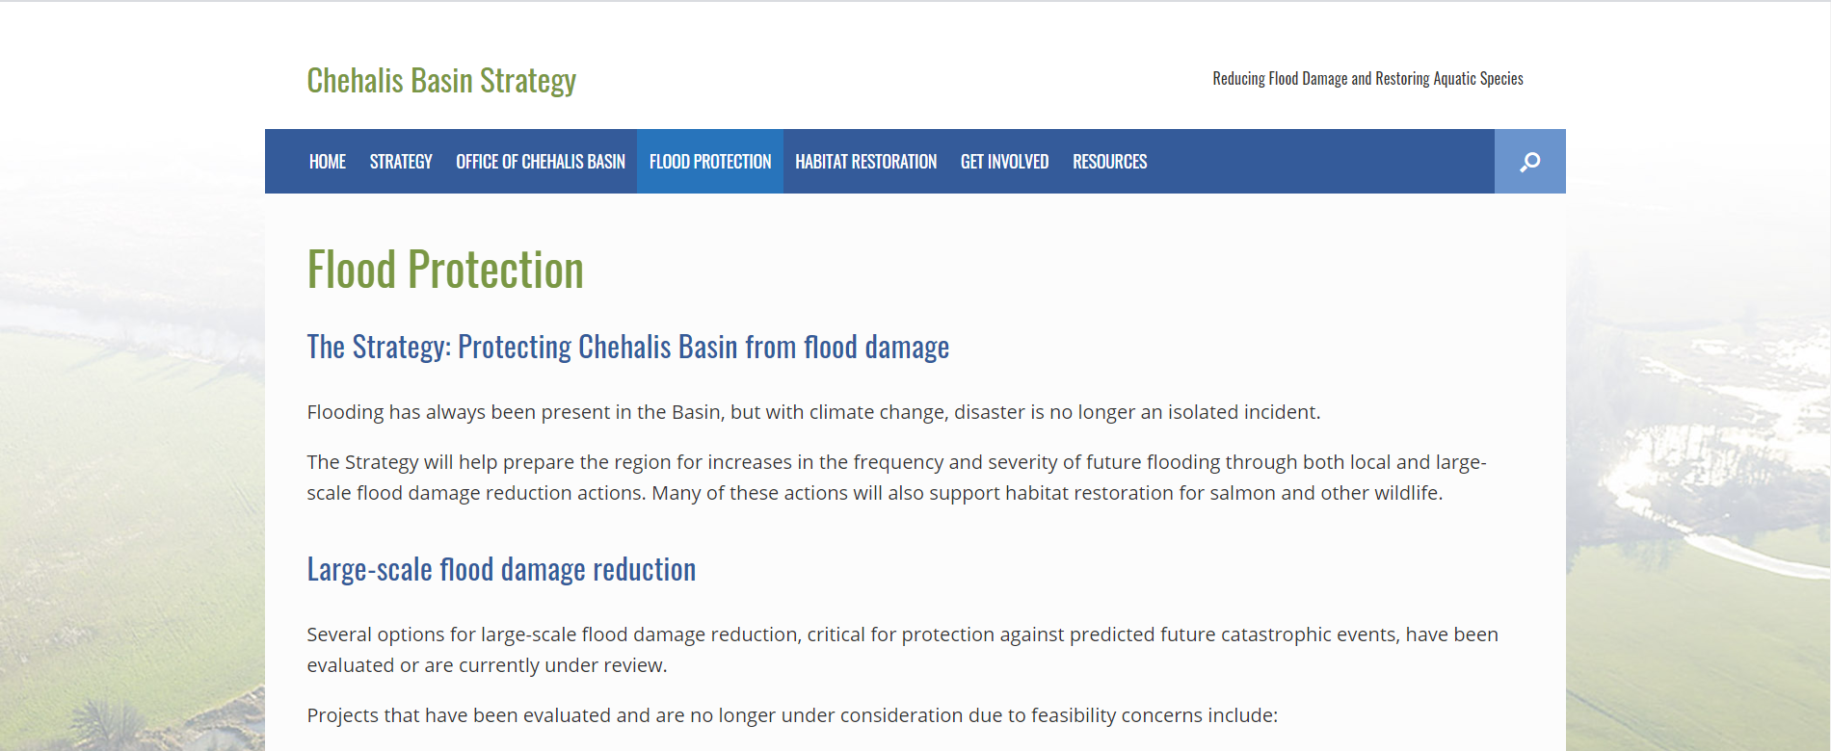
Basics of Floodplain Regulations
Break
Reconvene at 2:45

Slide 2
New Buildings
Definition of “building”
Residential buildings
Enclosures and crawlspaces
Non-residential buildings
Manufactured homes and RVs
Accessory buildings

Slide 3
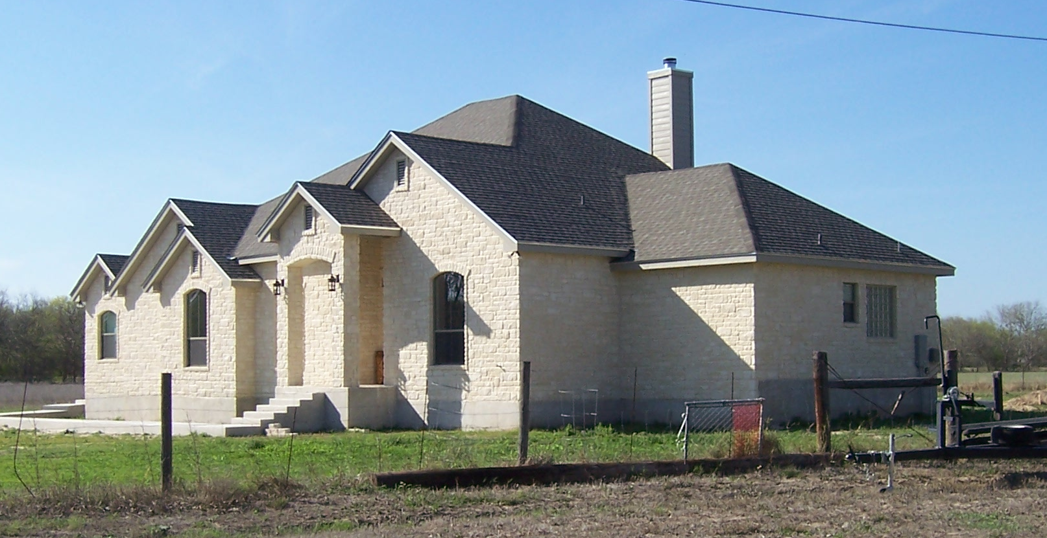
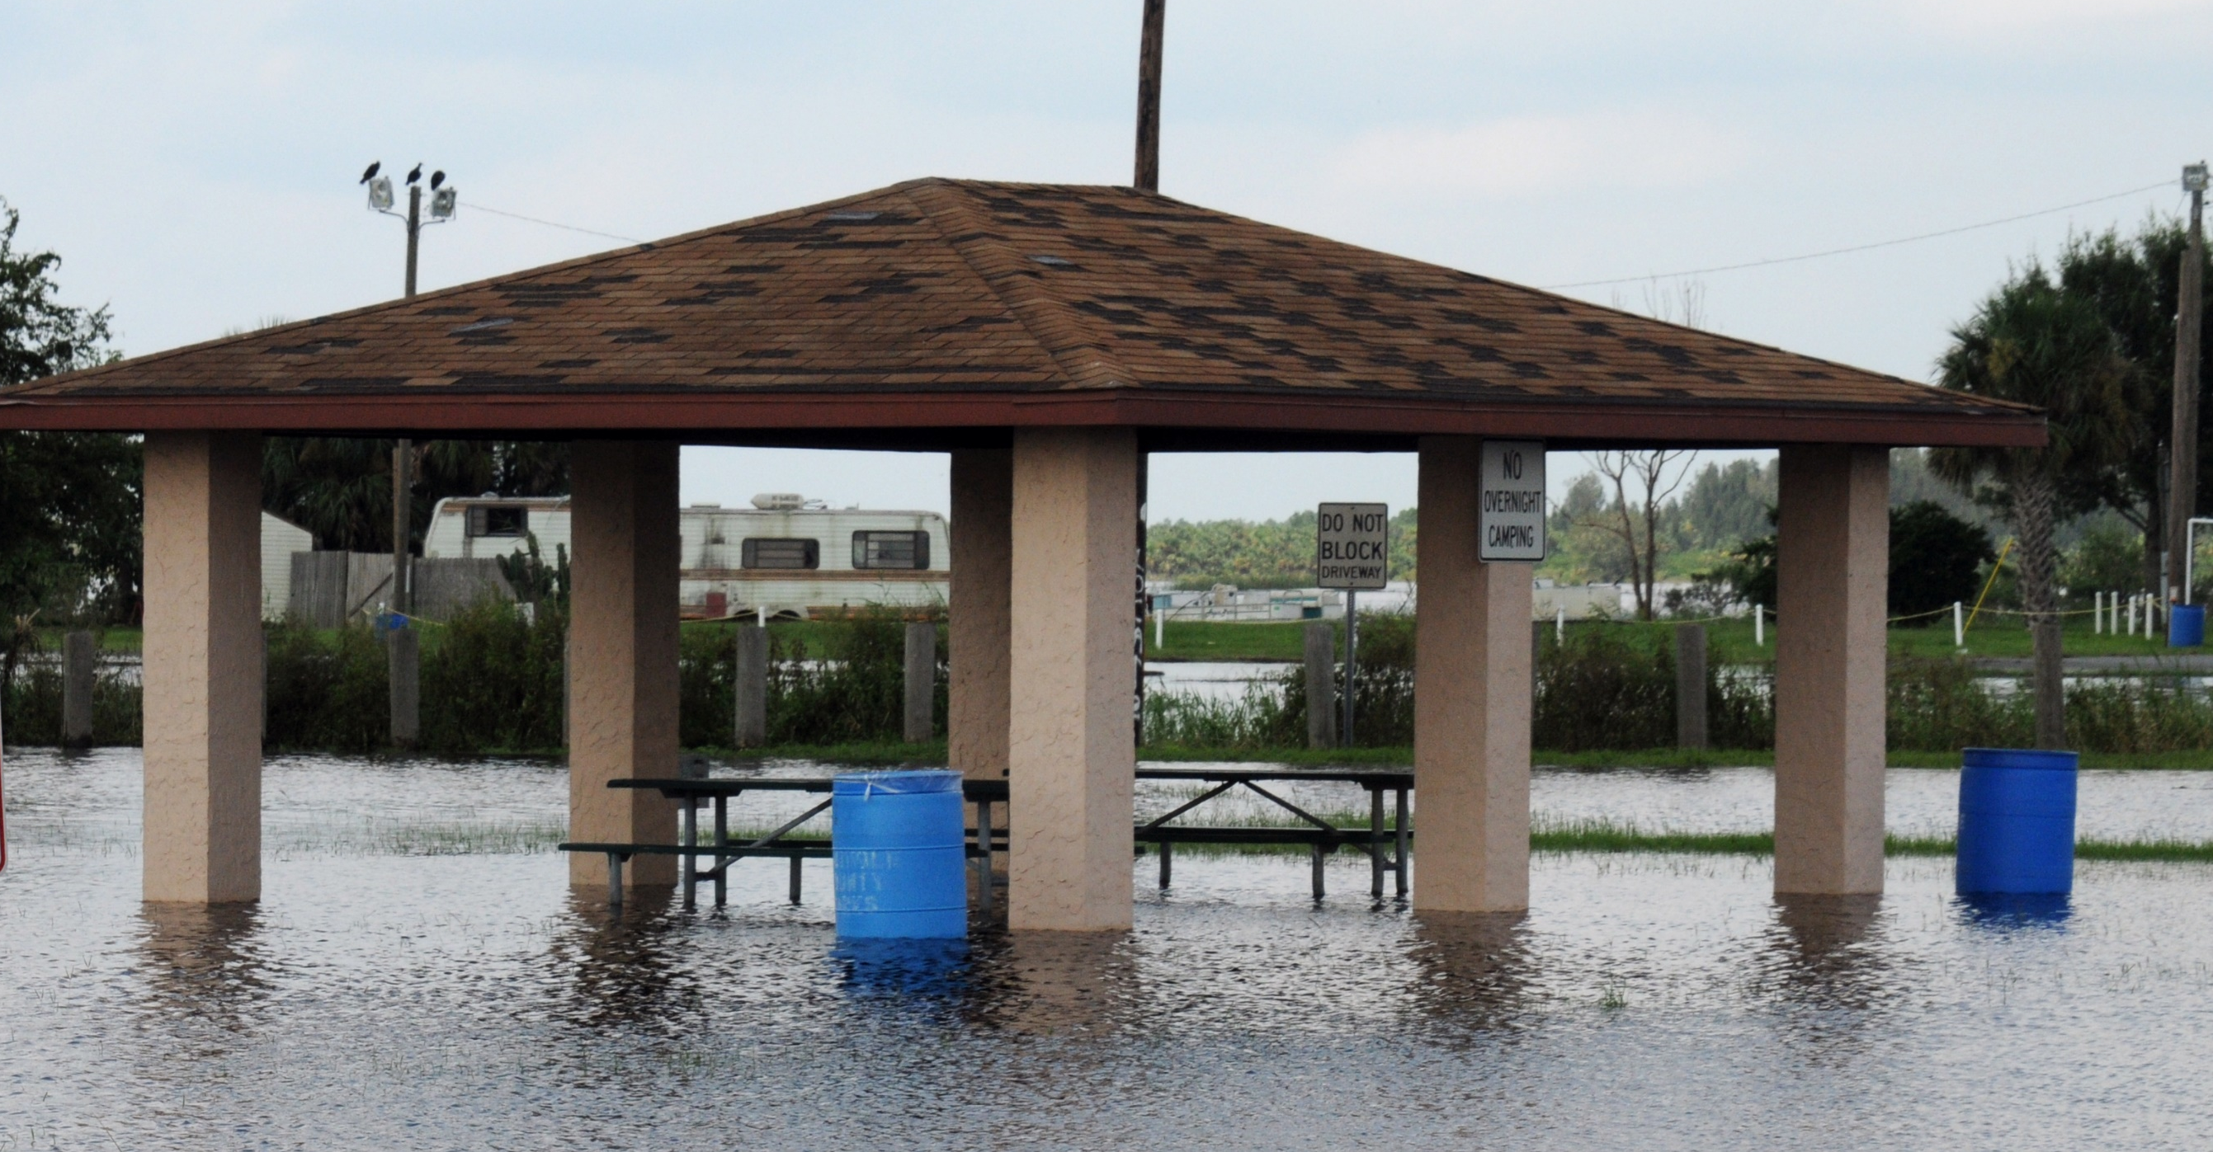
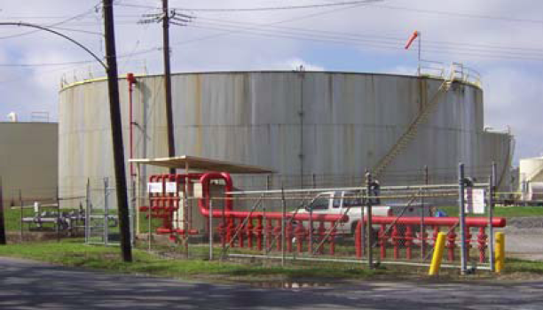
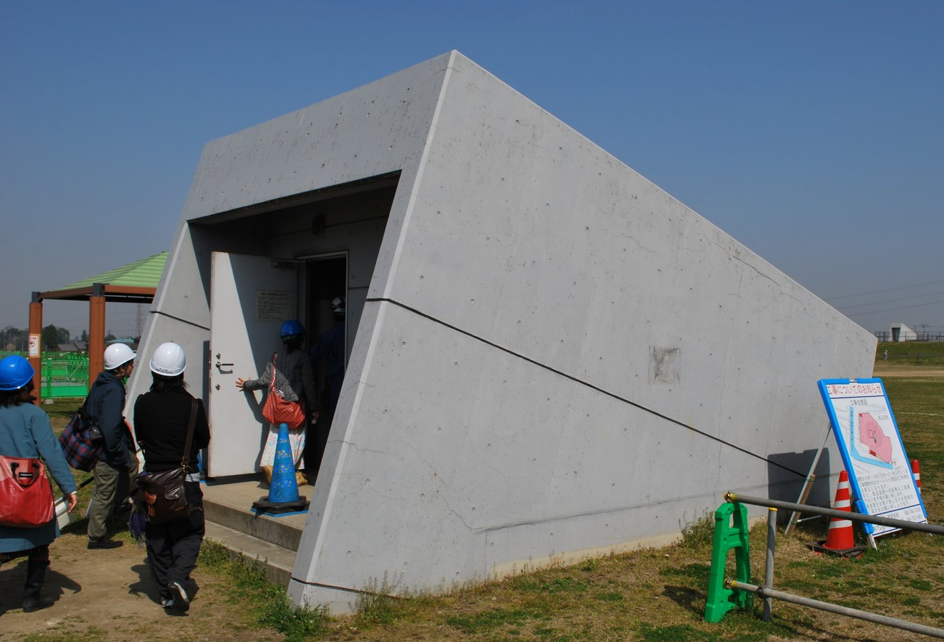
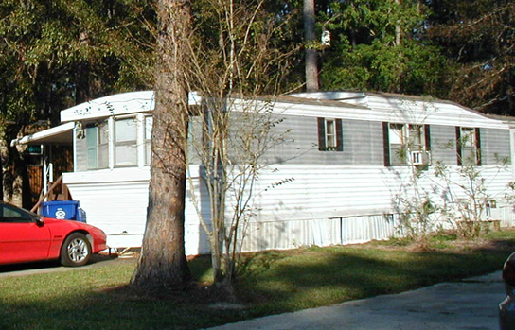
5-27
“Building” and “structure”
Walled and roofed
Gas/liquid storage tanks
Principally above ground
Manufactured homes

Slide 4
Building rules apply:
Construction of a new building
Substantial improvement
Repairing substantial damage
Placing a manufactured home on a site
Placing a recreational vehicle or travel trailer on a site for more than 180 days

Slide 5
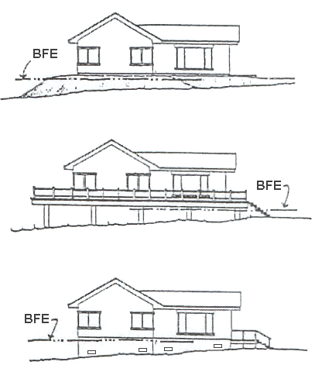
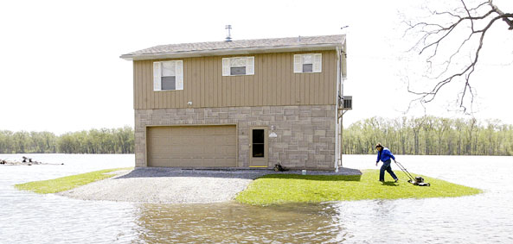
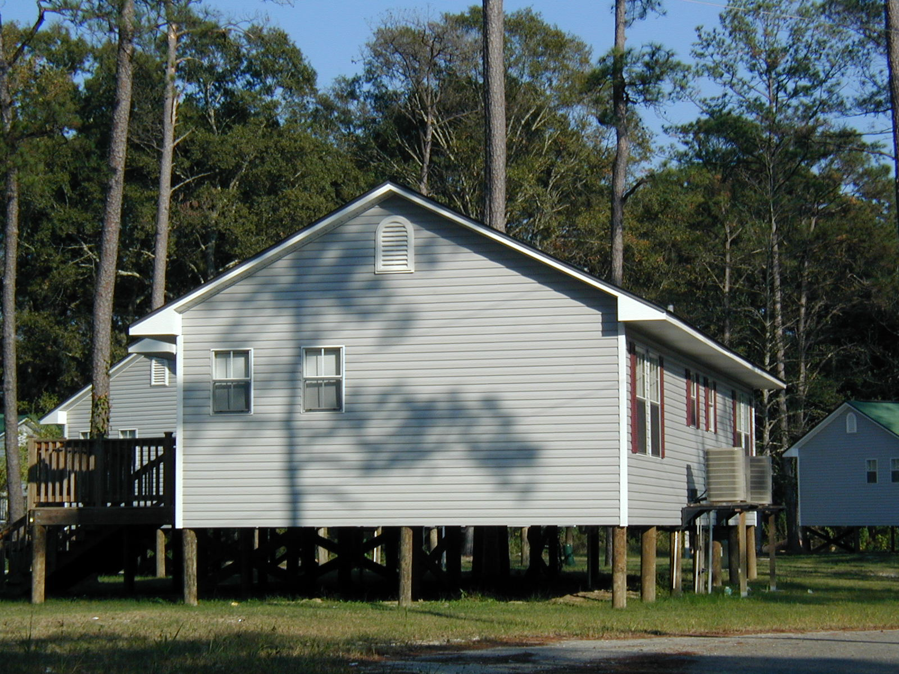
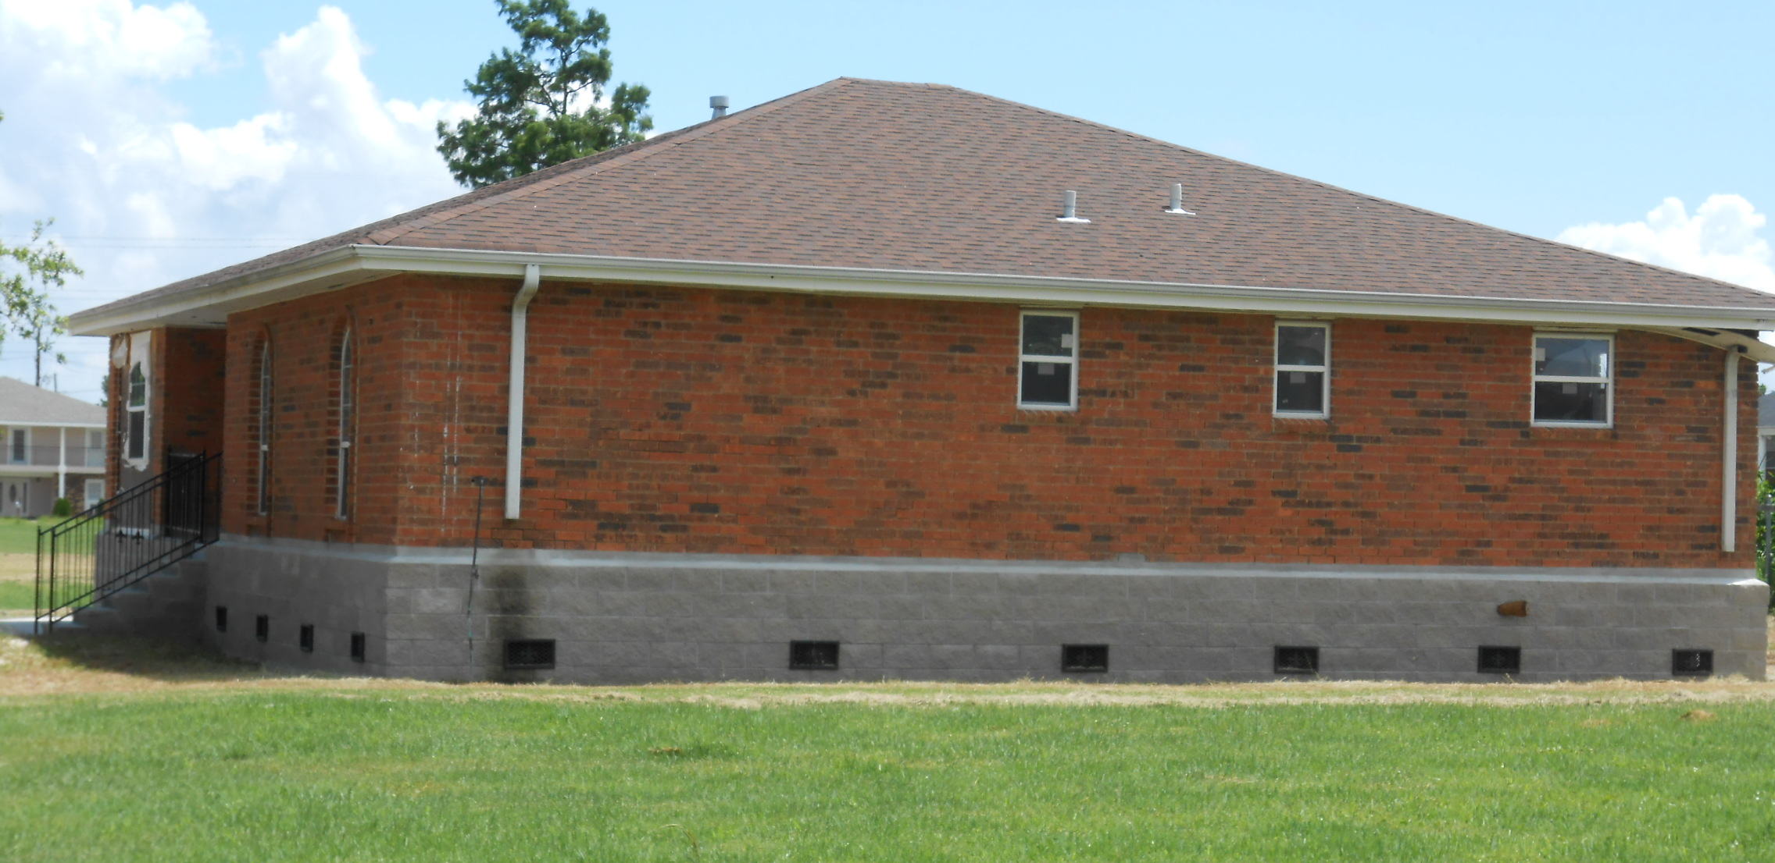
5-27
  Residential buildings
  Lowest floor > BFE

Slide 6
    Freeboard

Slide 7
5-31
How high? Where is the “Lowest floor?”

Slide 8
5-31
How high? Where is the “Lowest floor?”
Elevation Certificate
Section C2
Top of bottom floor
Top of next higher floor
Slab

Slide 9
5-31
How high? Where is the “Lowest floor?”
C2.b
Elevation Certificate
Section C2
Top of bottom floor
Top of next higher floor
Crawlspace

Slide 10
5-31
How high? Where is the “Lowest floor?”
Piers, pilings
Elevation Certificate
Section C2
Top of bottom floor
Top of next higher floor
Bottom of lowest horizontal structural member (V Zones only)

Slide 11
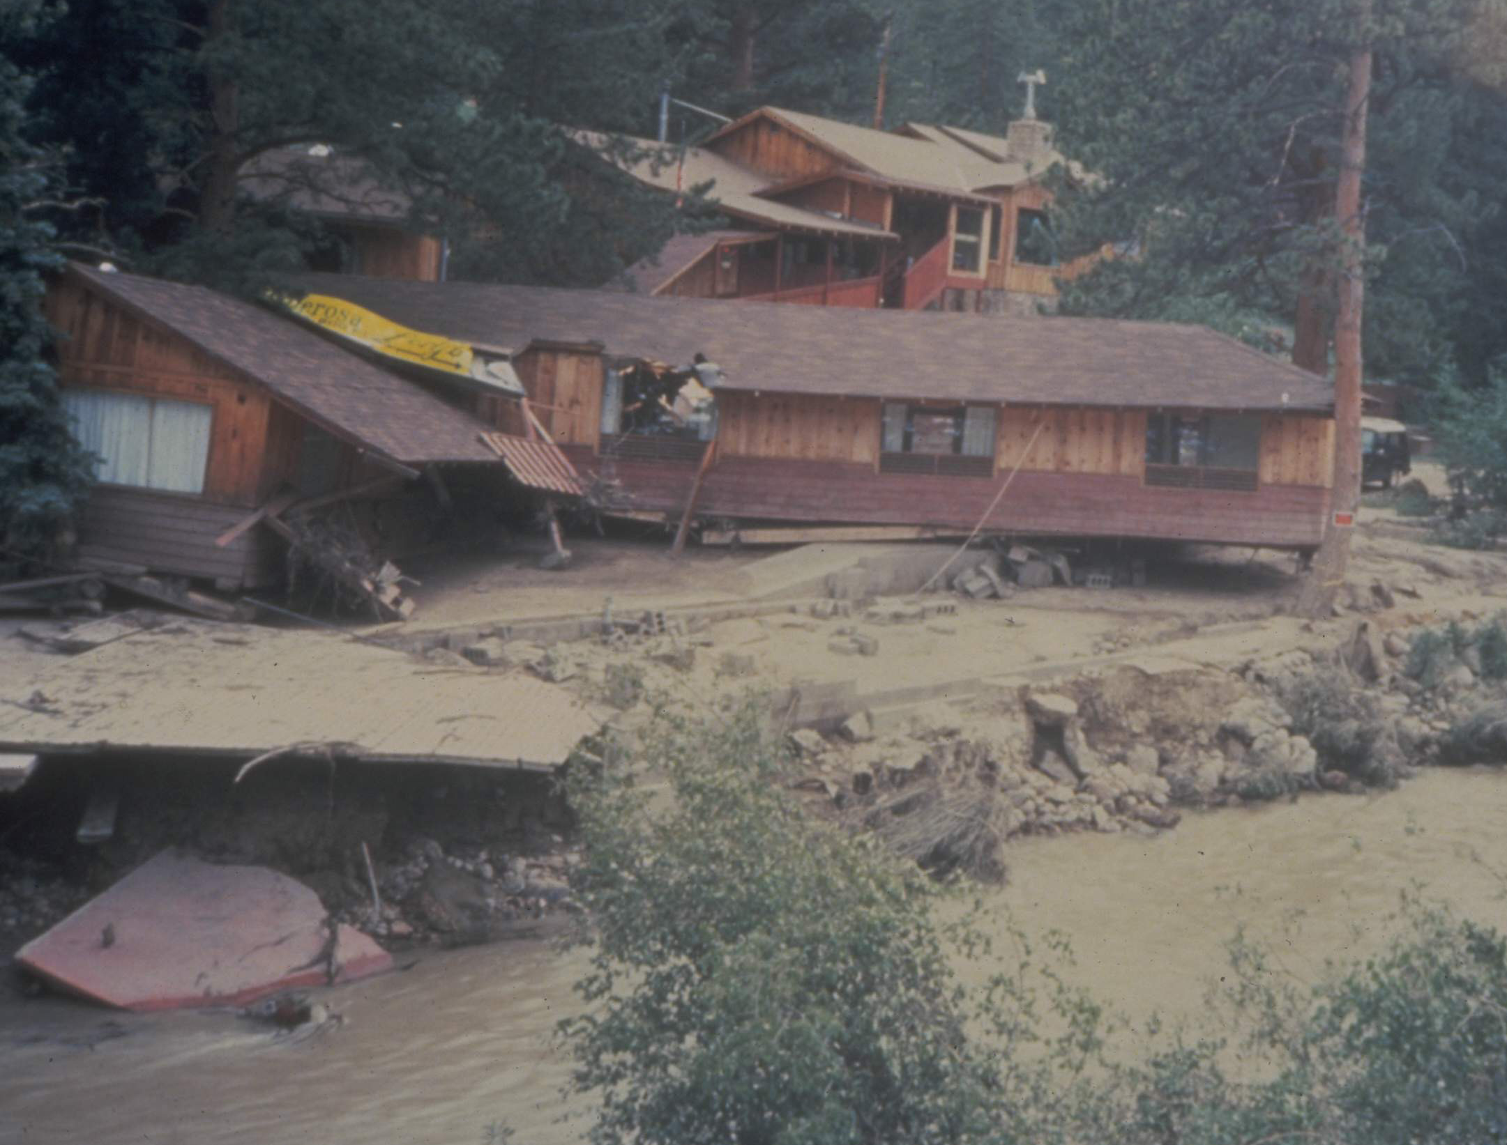
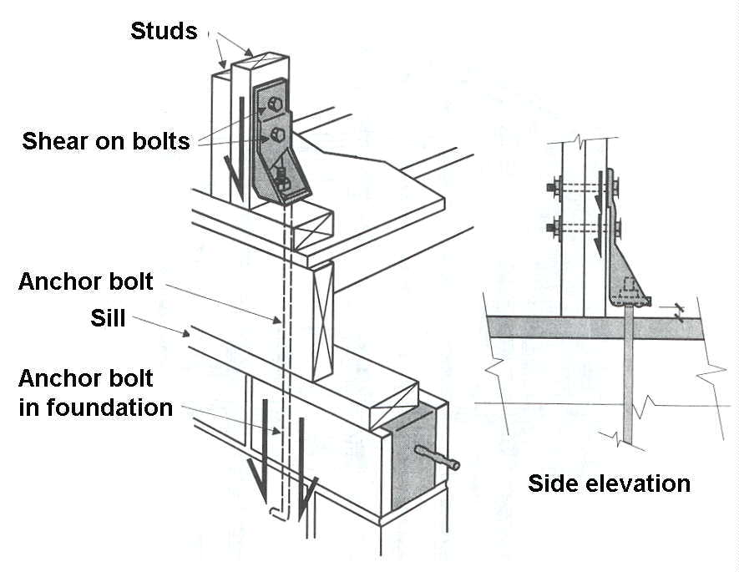
5-42
  Anchoring
  Flood > 5 feet per second
  Coastal waves
  Manufactured homes
    Get engineer’s/architect’s
    statement that anchoring
    is adequate for the conditions

Slide 12
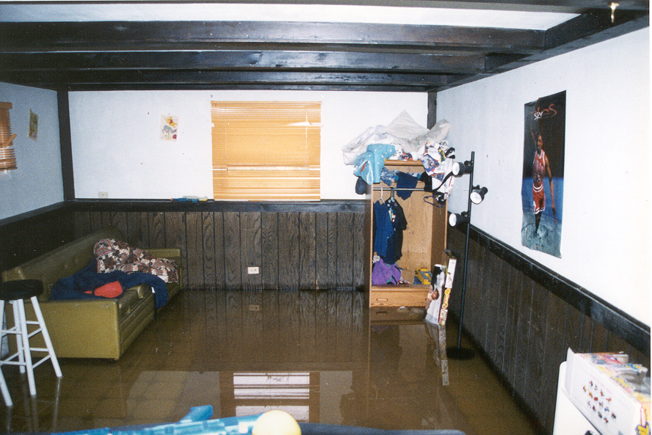
5-32
Enclosures and crawlspaces
Problem: damageable materials
  Allowable uses:
  Building access
  Vehicle parking
  Storage of materials with low damage potential

Slide 13
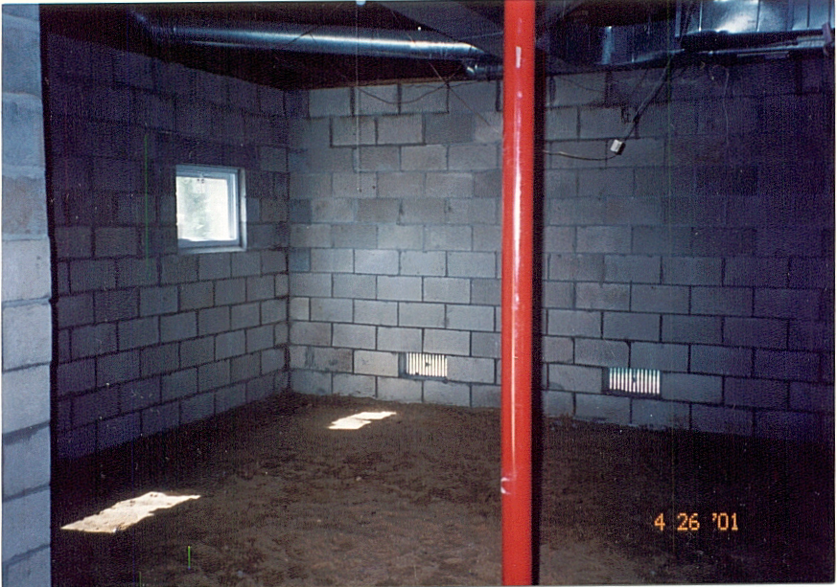
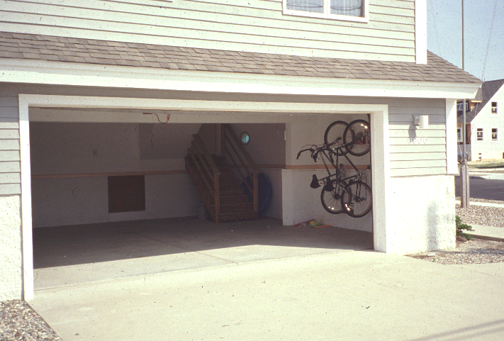
5-43
Enclosures and crawlspaces
Allowable uses

Slide 14
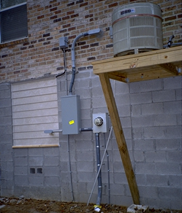
Enclosures and crawlspaces
Elevate or protect
utilities
BFE

Slide 15
Elevation Certificate

Slide 16
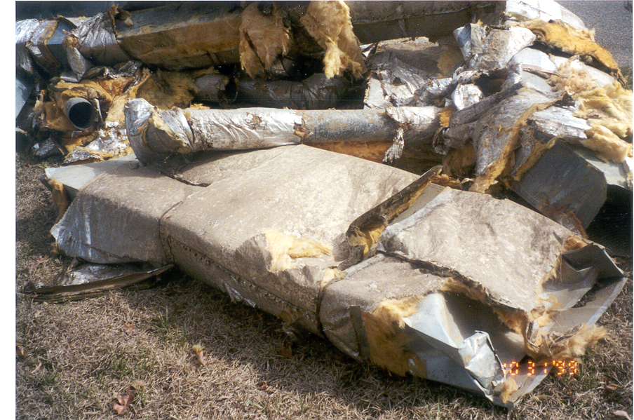
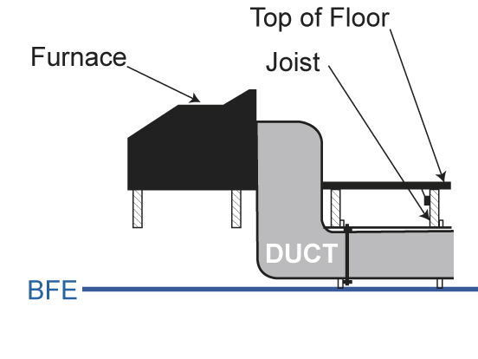
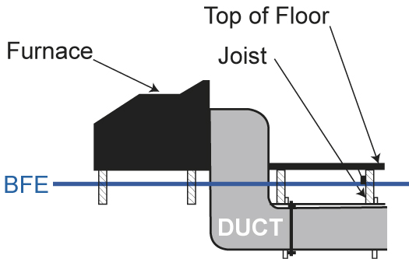
Duct work
+ freeboard
+ freeboard

Slide 17
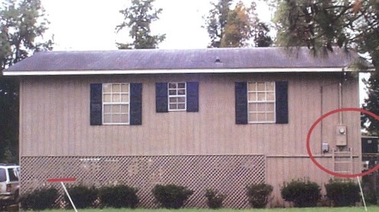
Polling Question
BFE

Slide 18
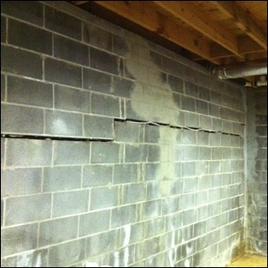
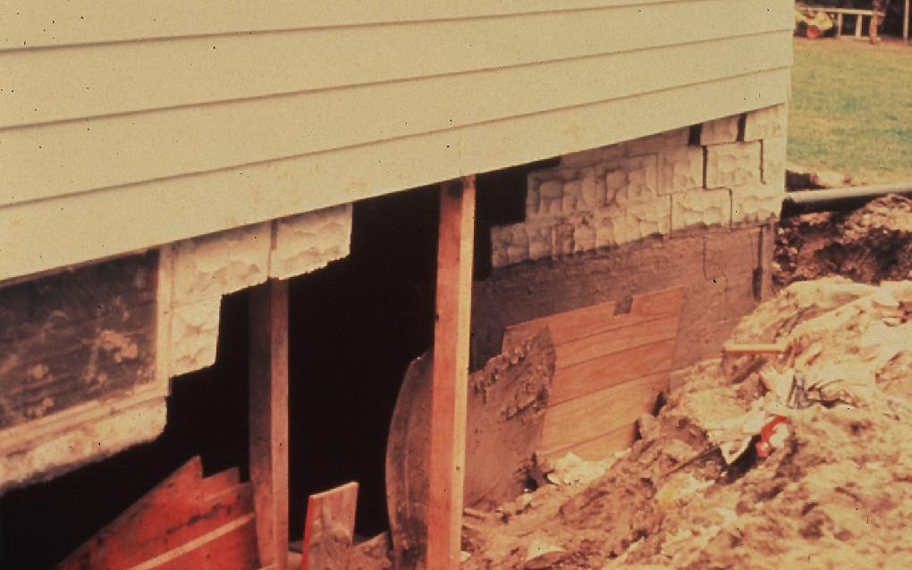
5-32
Enclosures and crawlspaces
Problem: water pressure on walls
  Let the water in to
  Equalize pressure

Slide 19
5-43
  Below the lowest floor
    Area used only for parking, storage, or building access
    AND
    Designed to automatically equalize hydrostatic flood forces
    BY
      Design certified by a registered professional engineer
      OR
      2 openings, total net area > 1 square inch for every square foot of enclosed area
      AND
      The bottom of all openings shall be no higher than one foot above grade

Slide 20
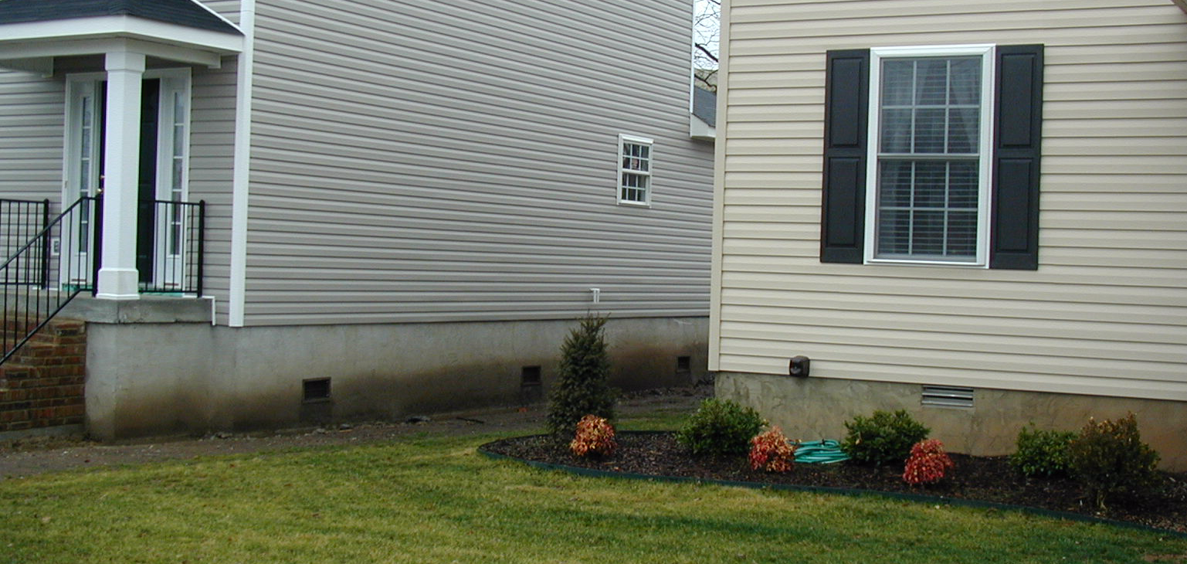
5-33
Openings
X
‾ Max 1 foot
> 2 openings
1 in² opening for each ft² of floor area

Slide 21
5-33
Openings
X
‾ Max 1 foot
2 walls
1 in² opening for each ft² of floor area

Slide 22
Elevation Certificate

Slide 23
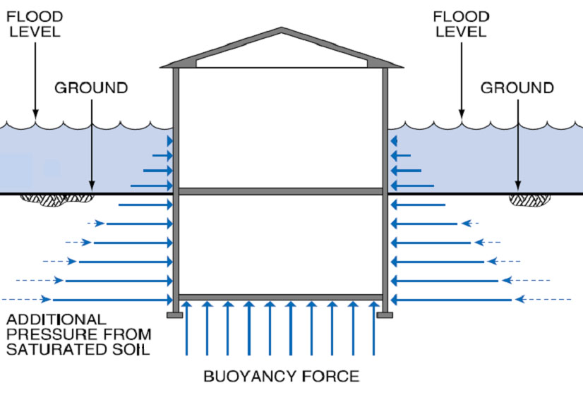
5-32
Enclosures and crawlspaces
Problem: water pressure increases with depth

Slide 24
Crawlspaces
Lowest Floor
OK
Basement

Slide 25
Elevation Certificate

Slide 26
Crawlspaces

Slide 27
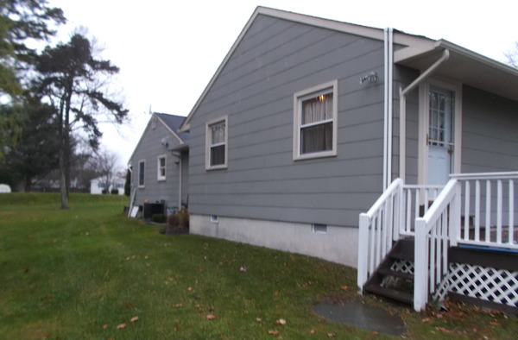
Polling Question
BFE

Slide 28
5-38
Nonresidential buildings
    Elevated like a residential building
    OR
    Dry floodproofed to the base flood elevation plus ___ feet.

Slide 30
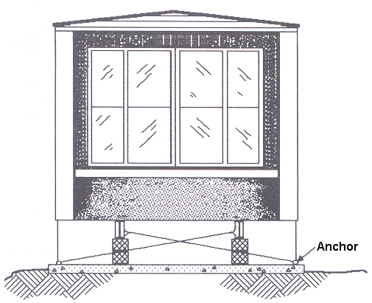
5-45
Manufactured homes
Defined in “Definitions”
Elevated like a residence
With Elevation Certificate
Securely anchored
Not in a floodway on the FIRM

Slide 32
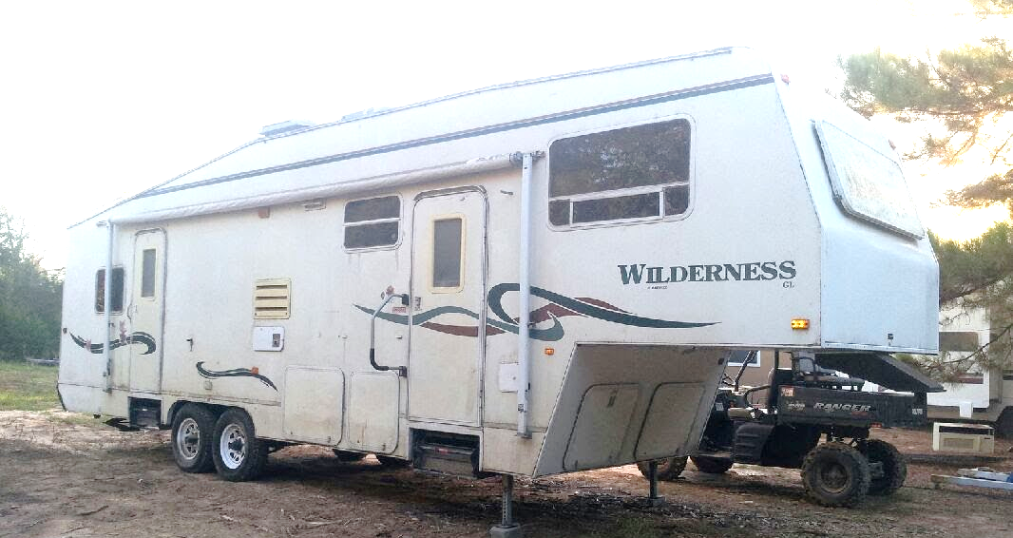
5-48
Recreational vehicles
Defined in “Definitions”
Be on site < 180 days
OR
Be licensed and on wheels
OR
Meet the requirements for manufactured homes

Slide 33
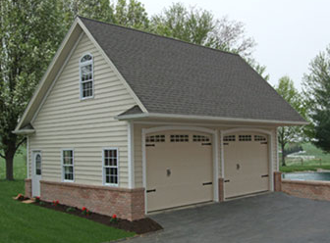
5-44
Accessory structures
Defined
< 500 square feet
Used only for parking and storage in relation to the principal building
Exempt from elevation requirement if
Resistant to flood damage below BFE + freeboard
Utilities above BFE + freeboard
Meets all crawlspace and opening requirements
Variance needed if not specified in the ordinance

Slide 34
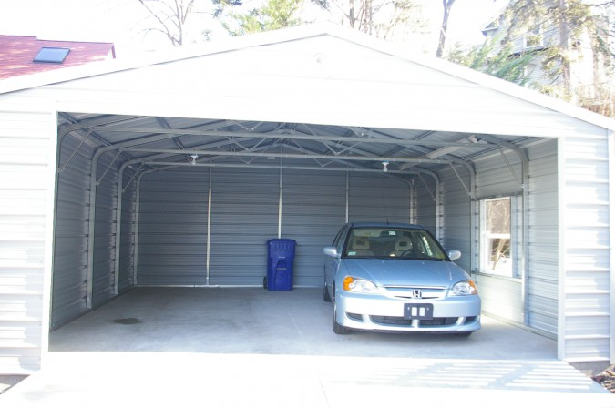
5-44
Accessory structures

Slide 35
Questions?

