Slide 1
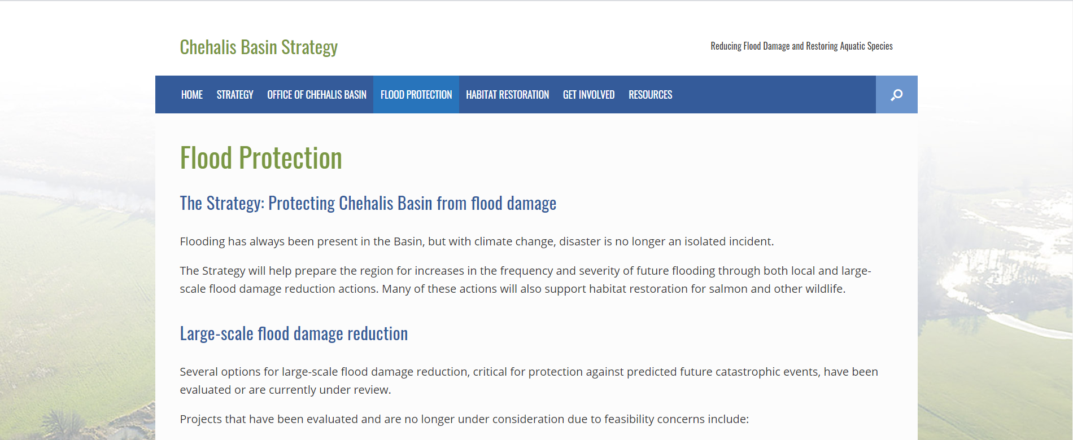
Basics of Floodplain Regulations
Welcome
Notes:
Presenters will include French, Jerry, and Alex. Last names and affiliations. Turn it over to Shelby to give a Zoom intro. Reiterate that you must be on Zoom and responding to the poll questions to get CECs.

Slide 2
Basics of Floodplain Regulations
Regulatory flood maps and data
General development standards
New buildings
Existing buildings
Administrative procedures

Slide 3
We Assume You Know
FEMA
National Flood Insurance Program
Local government building code and regulatory programs
If not
→ Introduction to Floodplain Management
Webinars, 7:00 pm, October 19 or 21

Slide 4
6-19
FEMA 480
Floodplain Management Desk Reference
Page numbers

Slide 5
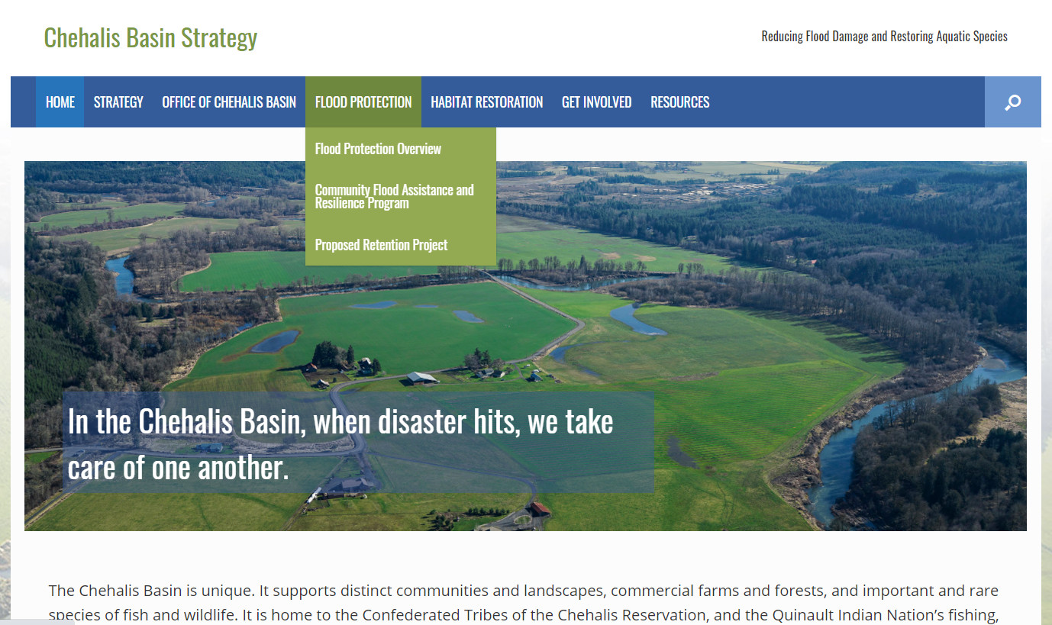
https://chehalisbasinstrategy.com/cfar/

Slide 6
Certified Floodplain Managers
3 continuing education credits (CECs)
We do the paperwork
You do the polling questions
Polling Question

Slide 7
For help:
Ordinance requirements and administration
Alex Rosen, Department of Ecology 360/407-6521, Alex.Rosen@ECY.WA.GOV
Mitigation/other floodplain management Chrissy Bailey, Department of Ecology Office of Chehalis Basin. 360/407-6781, Chrissy.Bailey@ECY.WA.GOV
Questions?

