Slide 1
Flood Maps and Data
Terminology
Base flood elevation
Floodways
Revising the FIRM
Best available data
Flood of record

Slide 2
3-3
Flood Study Terminology
Base flood
= 100-year flood
= 1% chance flood
BFE = base flood elevation
SFHA= Special Flood Hazard Area
= 100-year floodplain
= A and V Zones

Slide 3
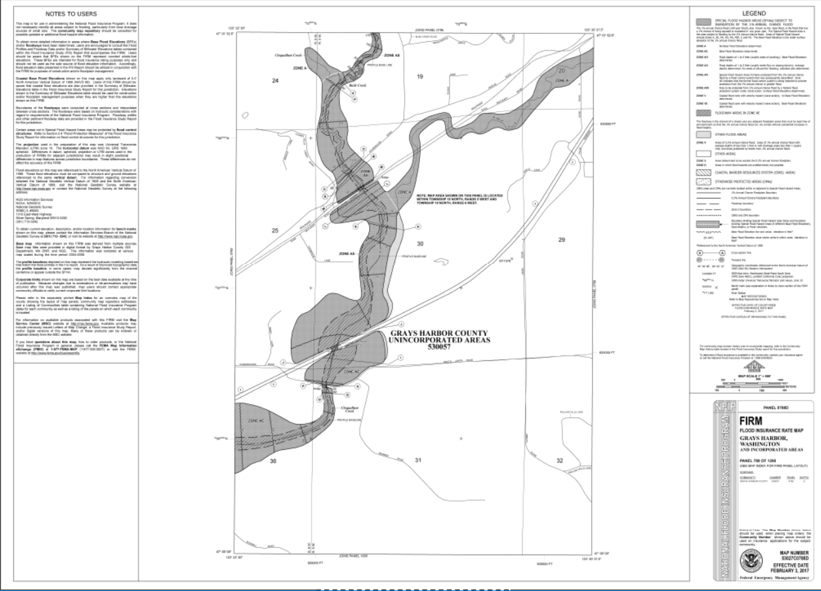
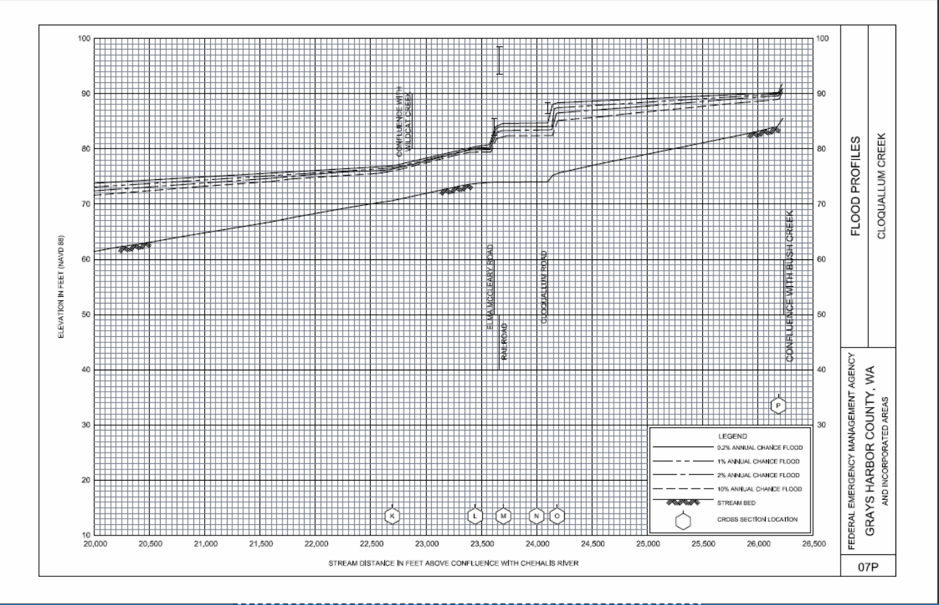
3-7
Flood Insurance Study
Text
Profiles
FIRM
Separate Flood Boundary Floodway Map
    (Lewis County)

Slide 4
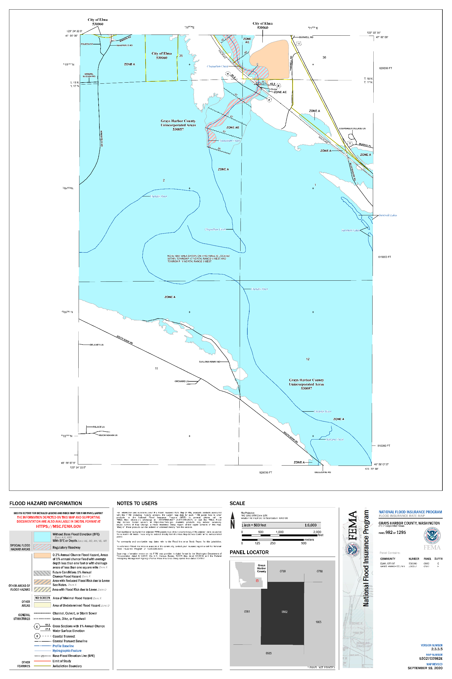
3-7
Flood Insurance Study
2020 Studies
Thurston County
Grays Harbor County
Text
Profiles
FIRM

Slide 5
Elevation Datums
NGVD 1929
National Geodetic
Vertical Datum
NAVD 1988
North American
Vertical Datum
Lewis County BFEs: add 3.42 feet
78.0 feet NGVD = 81.42 feet NAVD
Thurston and Grays Harbor County FIRMs
Now in NAVD

Slide 6
4-11
BFE in Coastal AE Zones

Slide 7
4-13
BFE in Riverine AE Zones
Riverine AE Zones
Always need
BFE to 0.1’

Slide 8
4-13
BFE in Riverine AE Zones
Riverine AE Zones
Always need
BFE to 0.1’

Slide 9
4-5
Riverine AE Zones
Always need
BFE to 0.1’

Slide 10
What is the base flood elevation at 4734 Lower Falls Creek Road?
4-13
4734

Slide 11
What is the base flood elevation at 4734 Lower Falls Creek Road?
4-13
250 feet
4734

Slide 12
4-13
BFE in Riverine AE Zones

Slide 13
4-13
BFE in Riverine AE Zones
10 squares = 500 feet
Each square = 50 feet

Slide 14
What is the base flood elevation at 4734 Lower Falls Creek Road?
4-13

Slide 15
What is the base flood elevation at 4734 Lower Falls Creek Road?
4-13
250 feet = 5 squares
??
Cloquallum
Road Bridge

Slide 16
4-13
What is the BFE?
250 feet = 5 squares
??
Cloquallum
Road Bridge

Slide 17
What is the base flood elevation at 4734 Lower Falls Creek Road?
4-13
250 feet = 5 squares
Cloquallum
Road Bridge

Slide 18
What is the base flood elevation at 4734 Lower Falls Creek Road?
4-13
250 feet = 5 squares
Polling Question
Cloquallum
Road Bridge

Slide 19
What is the base flood elevation at 4734 Lower Falls Creek Road?
4-13
250 feet = 5 squares
Polling Question
87.7
feet
Cloquallum
Road Bridge

Slide 20
What is the base flood elevation at 4734 Lower Falls Creek Road?
4-13
Double check
the elevation
makes sense
87.7 feet
4734

Slide 21
4-11
Floodways
Floodway boundary
Cross section

Slide 22
5-21
Cross section view

Slide 23
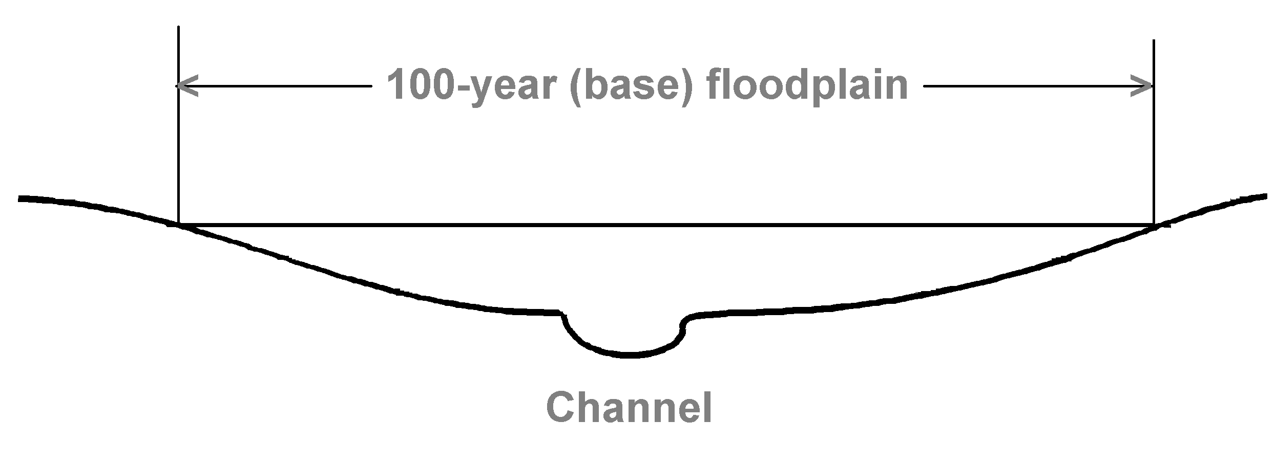
5-21
Cross section view
Fringe Floodway Fringe
BFE
+ 1 foot

Slide 24
4-5

Slide 25
4-11
Floodway boundary
Measure the distance from a known point on the ground to the floodway boundary on the map.
Locate and mark the boundary on the site plan and the ground.

Slide 26
4-20
Revising the FIRM
Reason for Change | Type of Change
New study with new flood elevations | Map Revision or LOMR
New study with new floodway | Map Revision or LOMR
New flood control project | Map Revision or LOMR
Annexation changes corporate limits | Map Revision or LOMR
Building on natural ground above BFE | Letter of Map Amendment (LOMA)
Vacant lot above BFE | Conditional LOMA (CLOMA)
Site filled above BFE | LOMR-F
Site proposed for filling to above BFE | Conditional LOMR-F (CLOMR-F)

Slide 27
4-20
Filling
  Fill placed before FIRM date → LOMA
  Fill placed after FIRM date → LOMR-F
  In both cases,
    If there is a building, show that the lowest adjacent grade and the lowest floor are above the BFE
    If the lot is vacant, all of the lot must be above the BFE

Slide 28
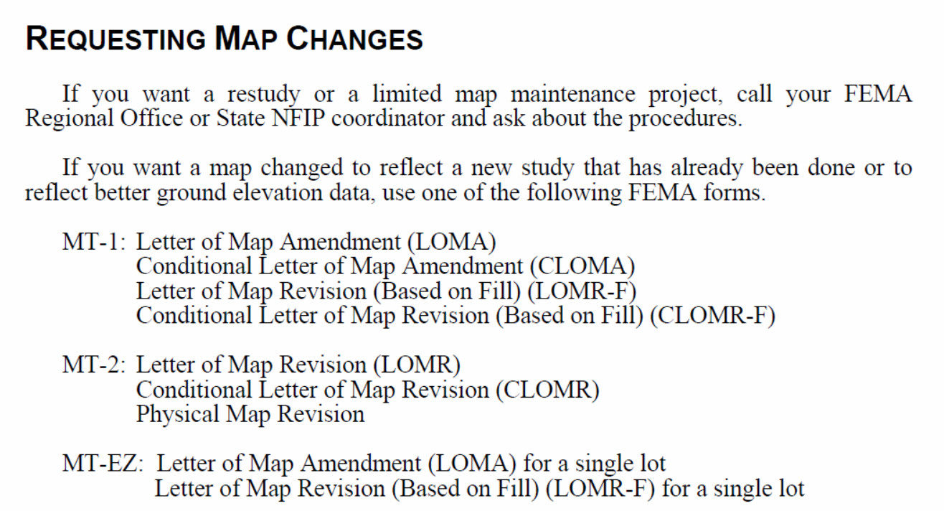
4-22

Slide 29
Best available data
Approximate A Zone: No BFE, no floodway

Slide 30
Best available data
No BFE
  Use best available data

Slide 31
Best available data

Slide 32
Best available data

Slide 33
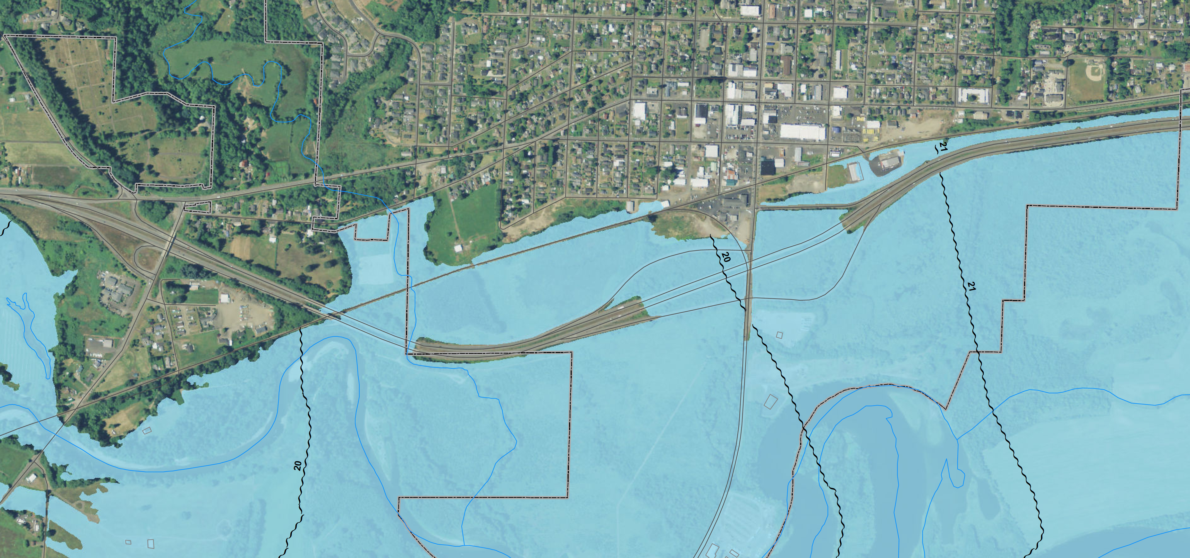
Best available data

Slide 34
Best available data

Slide 35
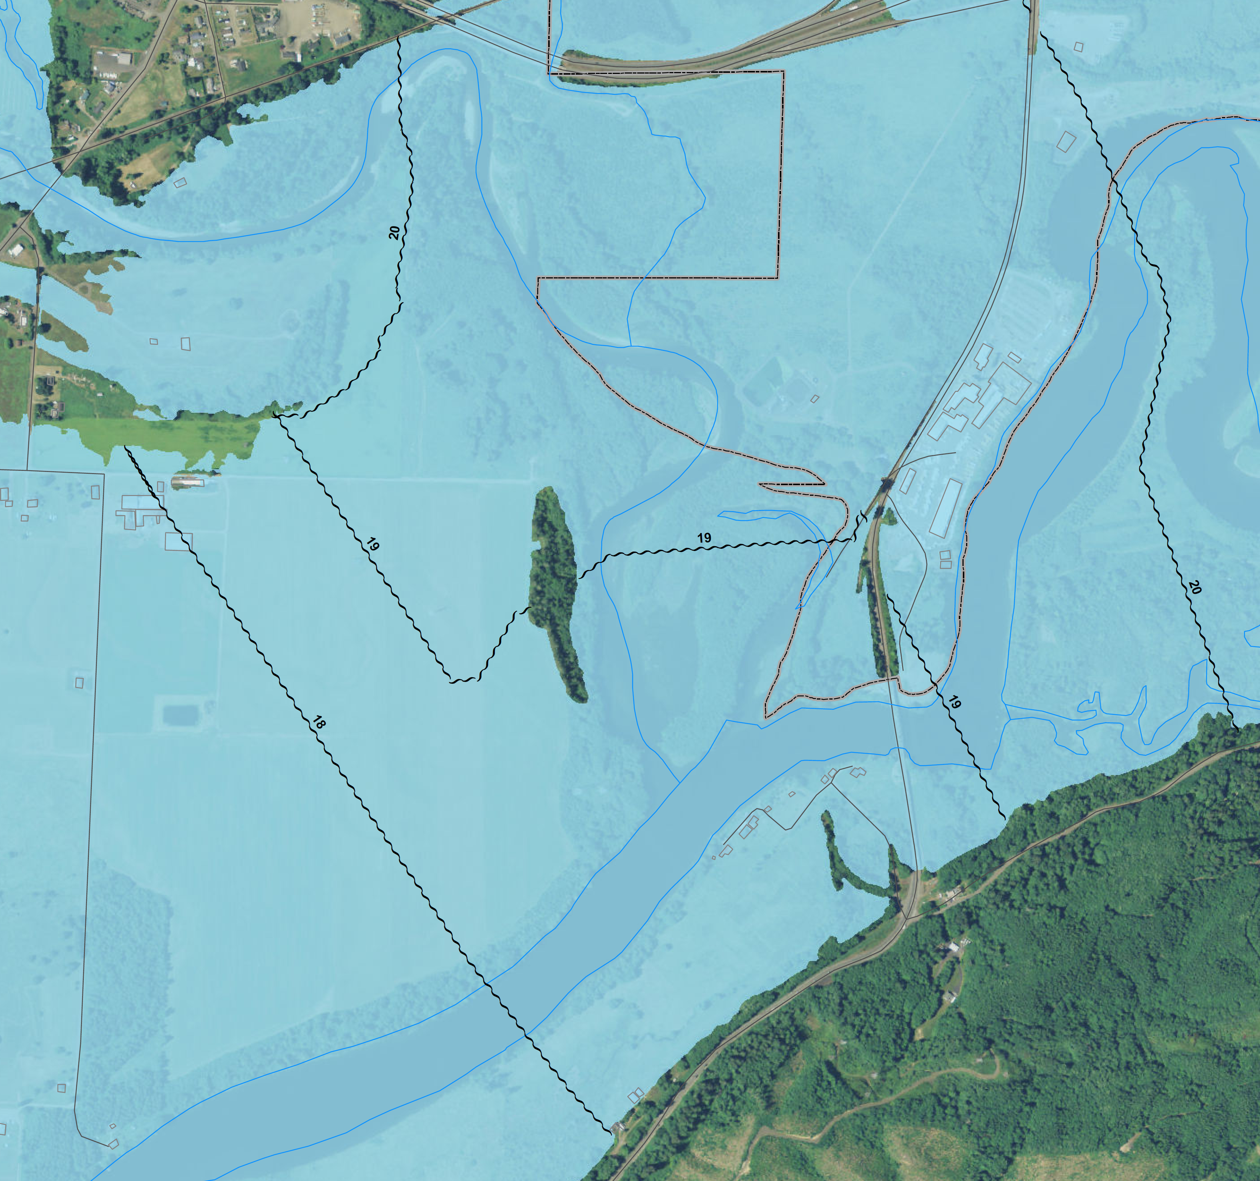
Getting a BFE on a WSE Map
19
20
19
19
18
80%
BFE = 18.8

Slide 36
Polling Question
Getting a BFE on a WSE Map
19
20
19
19
18
80%
BFE = 18.8

Slide 37
Polling Question
Getting a BFE on a WSE Map
30%
BFE = 19.3
19
20
19
19
18
80%
BFE = 18.8

Slide 38
No available data
Developments > 5 acres → Developer does a study
Flood of record recorded → Use the flood of record
Other situations → Call us

Slide 39
Best available data
No BFE
  → Use best available data
  If no BFE
  → Large developments: own study
  → Use the flood of record or call us
If flood of record (FOR) > BFE
→ Use the flood of record

Slide 40
Flood of record (FOR)

Slide 41
Flood of record

Slide 42
Flood of record
Use June 2020
Thurston County
FIS and FIRM
(WSE BFE)
WSE BFE > FOR
WSE BFE ≈ FOR
FOR > WSE BFE

Slide 43
Flood Insurance Study
Text
Profiles
FIRM
Questions?

