Slide 1
Existing Buildings
Substantial improvement
Exemptions
Cumulative improvements
Substantial damage

Slide 2
8-3
Substantial improvement
NFIP requirement:
If the cost of improvements
OR
the cost to repair damage
>
50% of the market value
Then
The building must meet
post-FIRM standards

Slide 3
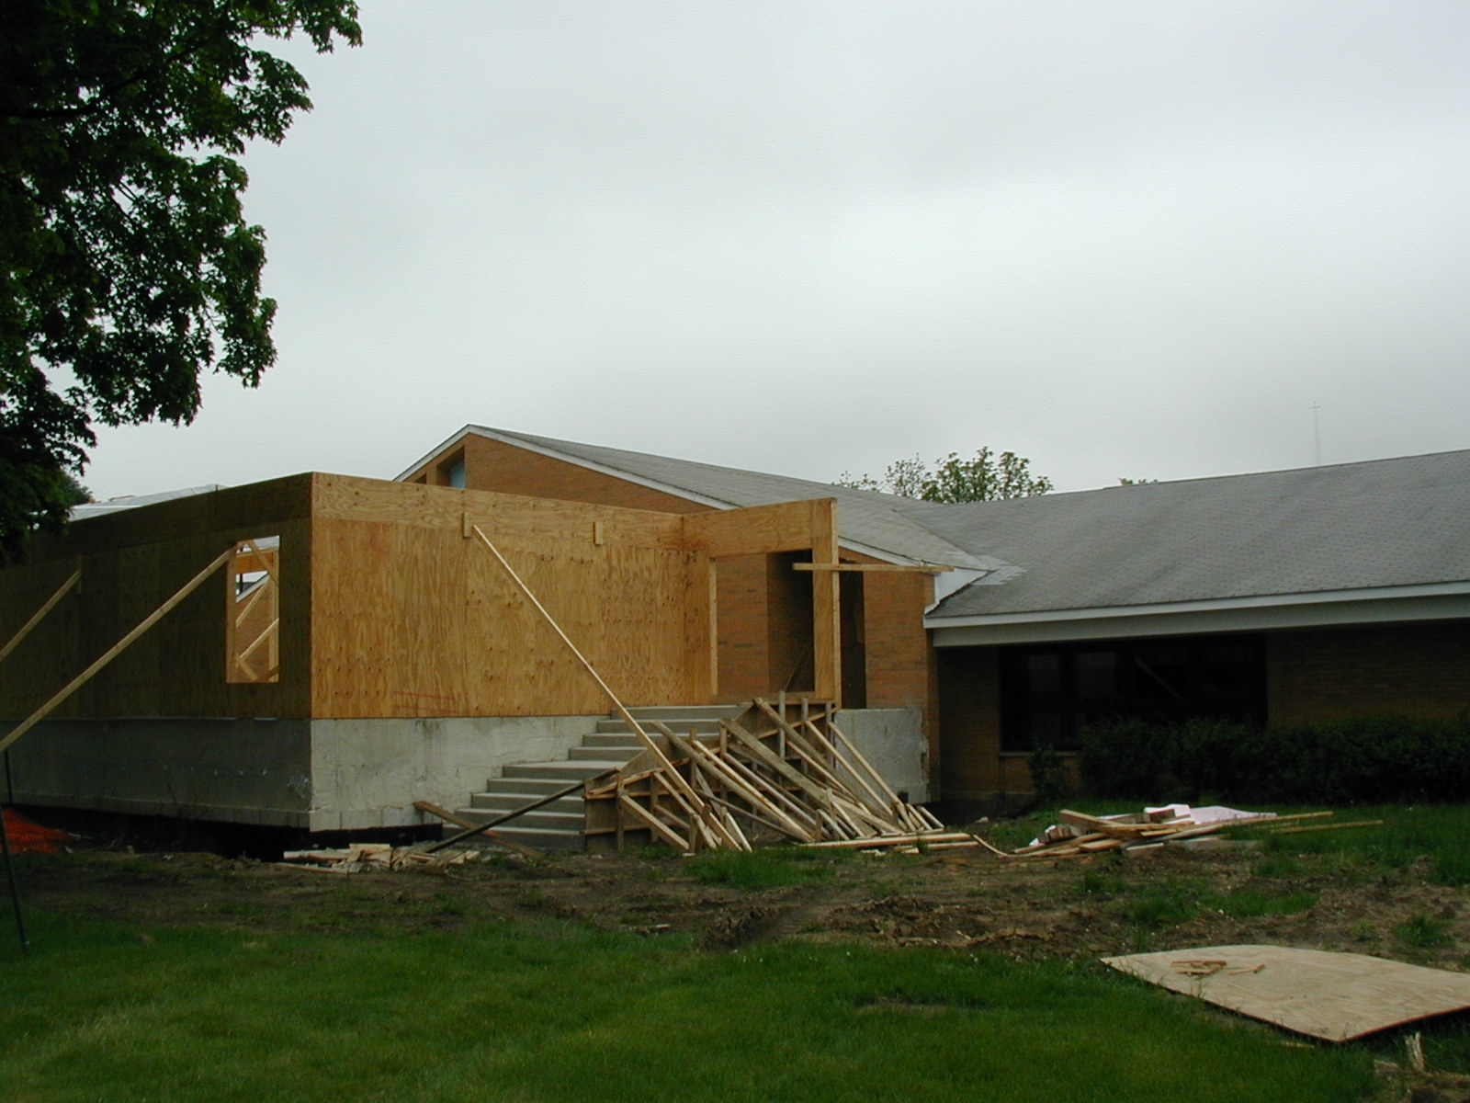
8-4
Projects affected
Remodeling
Rehabilitation
Additions
Repairs
Post-FIRM buildings
New FIRM Zone or BFE

Slide 4
8-5
The formula
Cost of improvement project > 50% Market value of the building
Example:
$60,000 project
$100,000 house
= 60%
= substantial
improvement
The house must be elevated to meet post-FIRM standards

Slide 5
8-6
Project cost
All structural costs, including:
“True” cost of all materials
“True” cost of labor
Built in appliances
Overhead, profit
Repairs/other work at the same time

Slide 6
8-6
Project cost
Can exclude:
Plans and specifications
Permit fees
Debris removal/clean up
Work not related to the building (e.g., landscaping, detached garage)

Slide 7
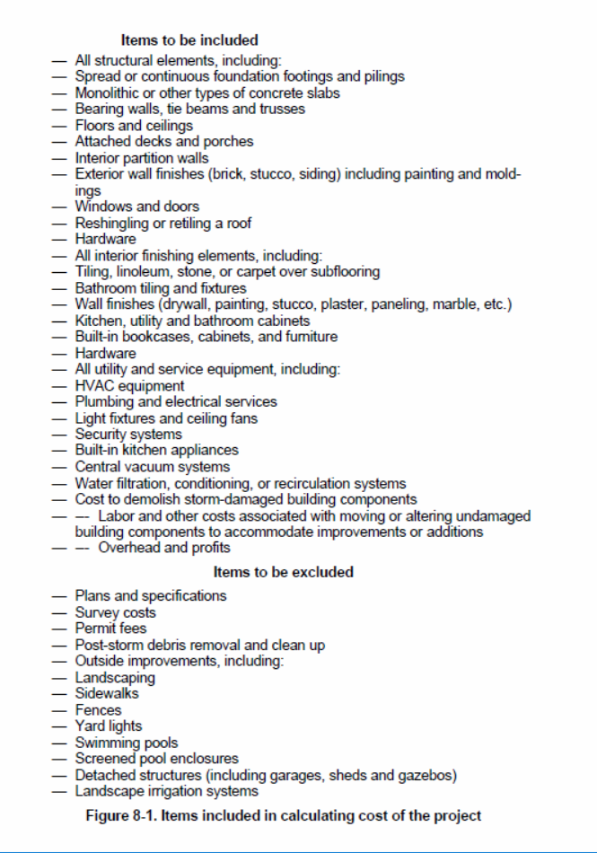
8-8
Project cost

Slide 8
8-5
The formula
Cost of improvement project > 50% Market value of the building

Slide 9
8-6
Market value
What a willing buyer would pay for the building. Sources:
Independent appraisal
County Assessor
Professional judgment
Typical approach: Assessor’s value with option for applicant to submit appraisal

Slide 10
8-6
County assessor data
Thurston County
Grays Harbor County
Lewis County

Slide 11
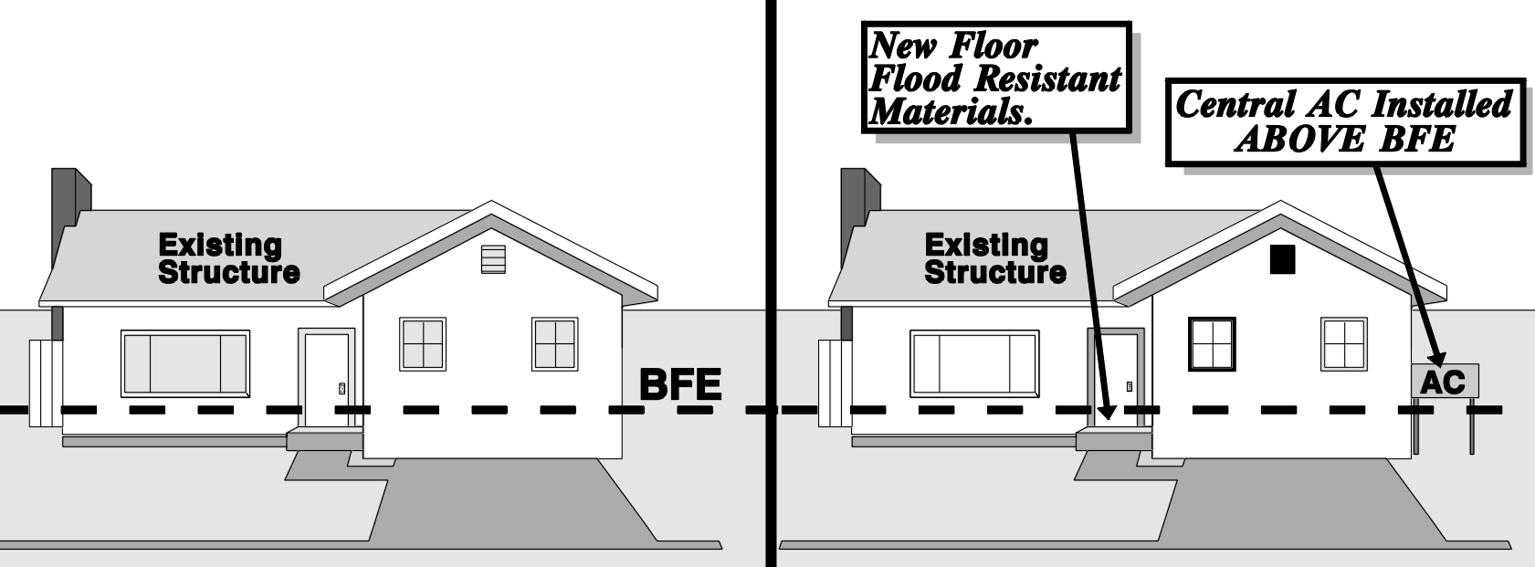
8-10
Substantial Improvement Examples
Example 1: Minor upgrade
AE Zone
Project: $12,000
Market: $60,000
$12,000 = 20%
$60,000
Not a sub. Imprvmnt.

Slide 12
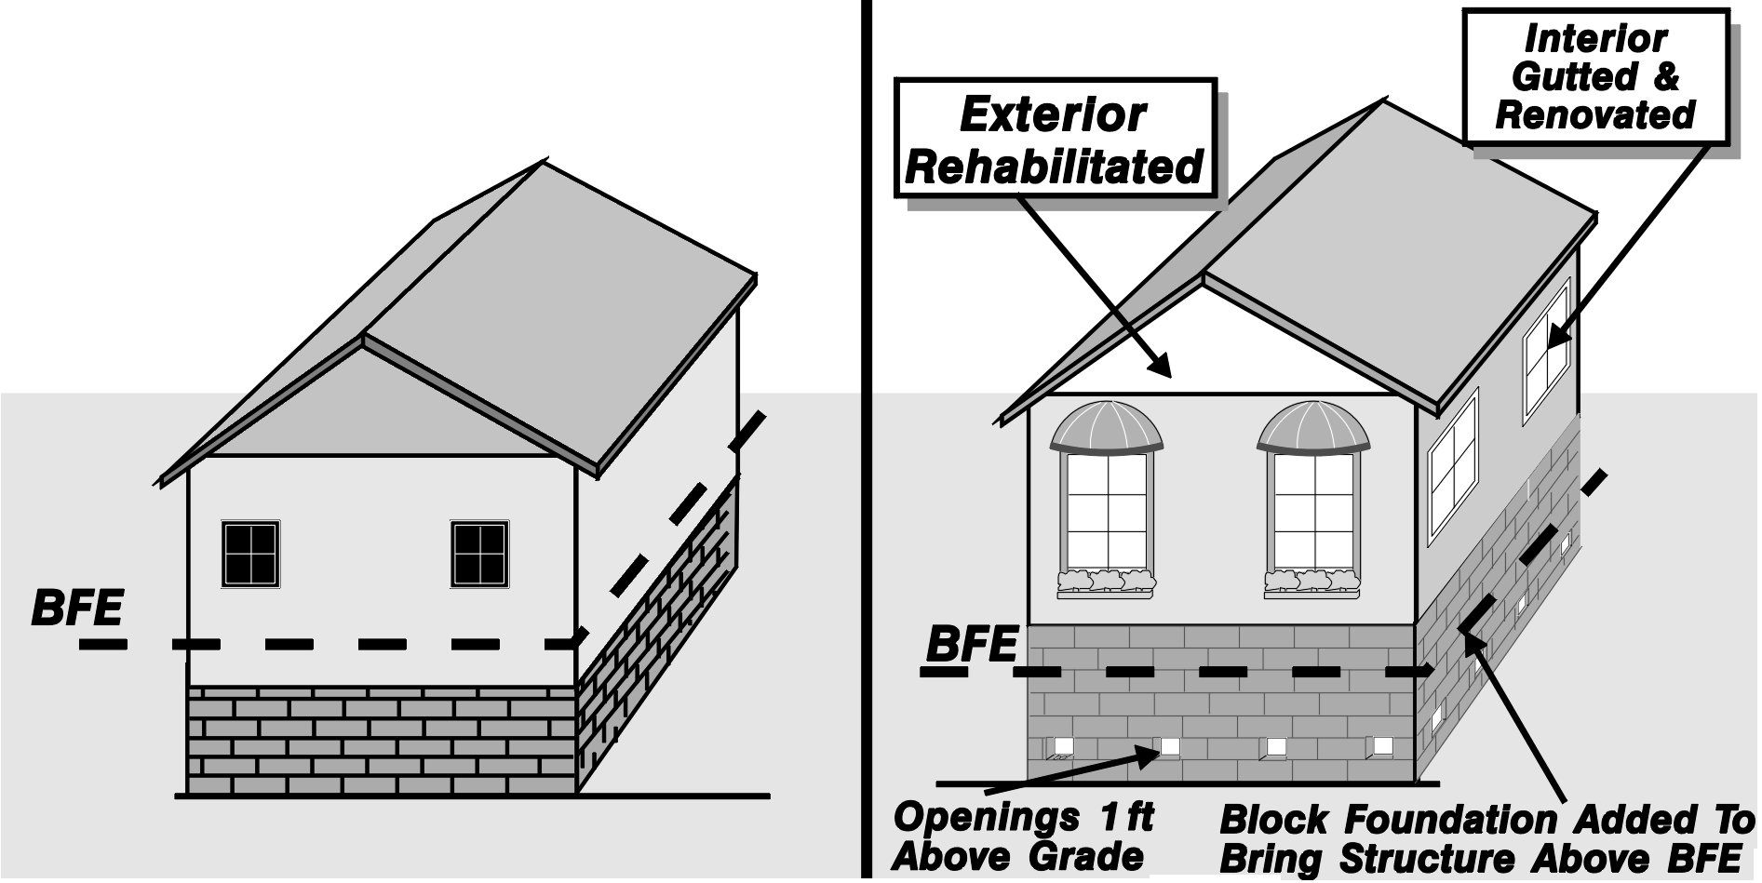
8-11
Example 2: Rehabilitation
Polling Question
AE Zone
Run down
Rehab: $25,000
Market: $35,000

Slide 13
8-11
Example 2: Rehabilitation
Polling Question
AE Zone
Run down
Rehab: $25,000
Market: $35,000
$25,000 = 71%
$35,000

Slide 14
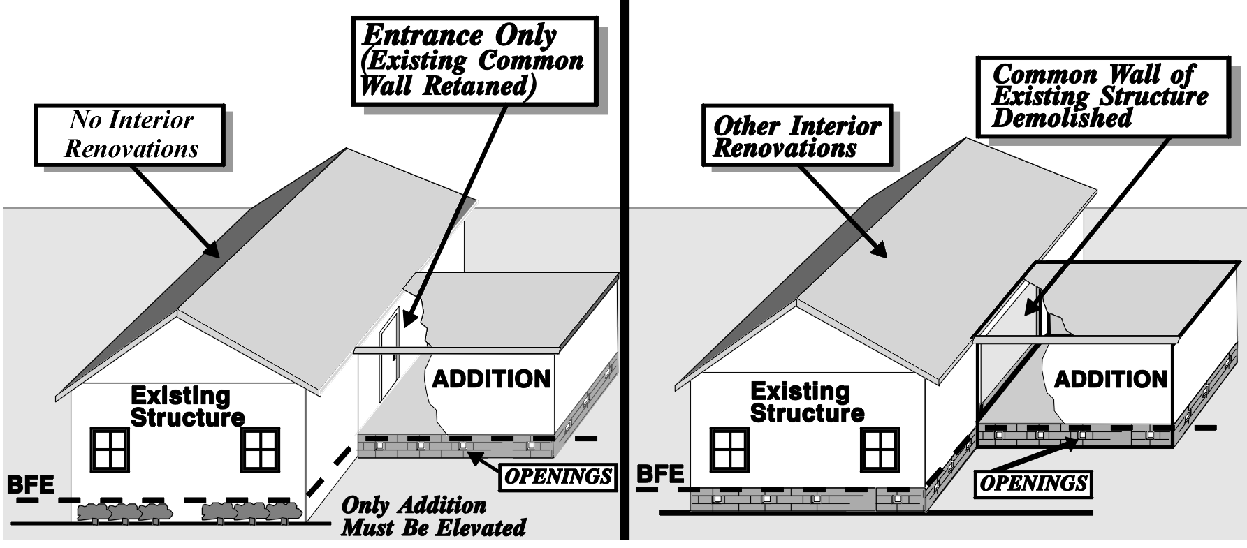
8-12
Example 3: Lateral addition

Slide 15
8-25
Exemptions
Existing code violations
Existing = already cited
Historic structures
Listed as historic
Keep the historic status
Take all possible flood protection measures

Slide 16
8-12
Example 3: Lateral addition
2020 project: 40%
2021 project: 25%
2022 project: 35%
2022: 100%

Slide 17
Cumulative improvements
Substantial Improvement: any repair, reconstruction, rehabilitation, addition, replacement, or other improve- ment of a structure taking place during a five year period, the cumulative cost of which equals or exceeds 50 percent of the market value of the structure before the improvement or repair is started.
Rolling five years
Can start counting from date of ordinance
Record keeping is vital

Slide 18
Cumulative improvements
Calculate the percentage of current market value
Add up the percentages over time
5-19

Slide 19
Cumulative SI/SD

Slide 20
8-18
Substantial damage
Cost to repair > 50% Market value of the building
Damage from any cause
All buildings, regardless whether insured
“True” cost to restore the building to its pre-damaged condition
Regardless whether the owner wants to restore everything

Slide 21
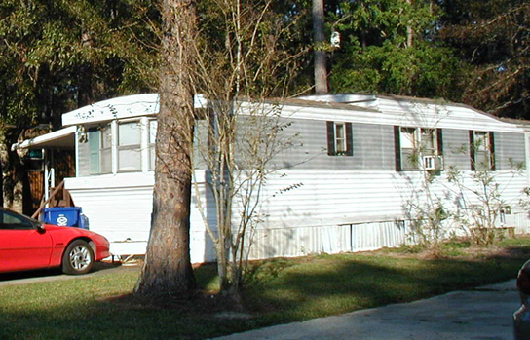
Manufactured homes
If substantially damaged
→ meet post-FIRM standards
If replaced by a new one
→ meet post-FIRM standards
If evacuated to avoid damage
→ OK to replace at old elevation (provided not substantially improved)

Slide 22
Come to the workshop on
“Regulating After a Disaster”
November 2, 1:00 via Zoom
Questions?

